Slide 1
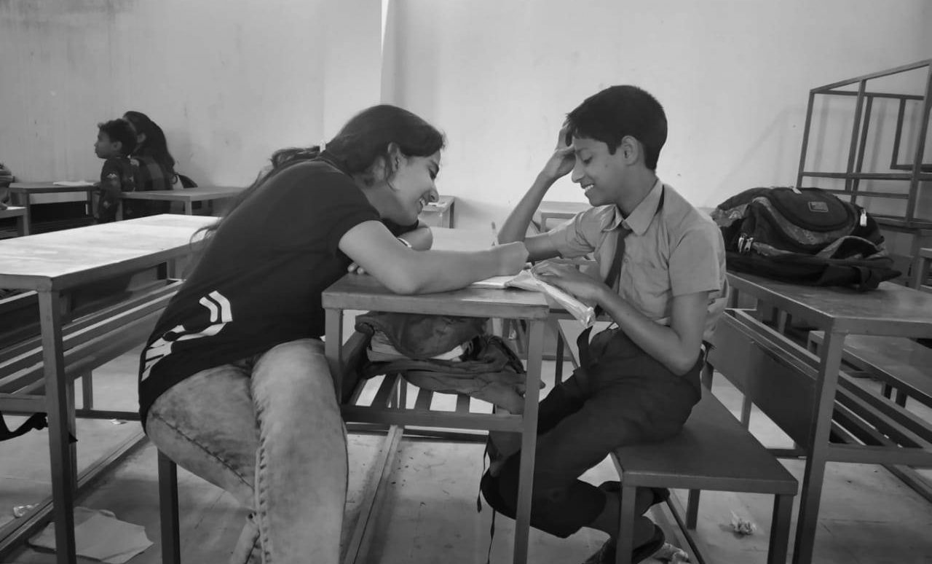




HOME ABOUT US STORIES OUR TEAM CONTACT US
izyatna
Aspiring Dreams
Register

Slide 2


Only for students of SVVV
Name
Email
Year
Branch
Submit

Slide 3

HOME ABOUT US STORIES OUR TEAM CONTACT US
About Us
2
Vision
Schools
Vision here
300
Mission
Students
90
Mission here
Volunteers

Slide 4

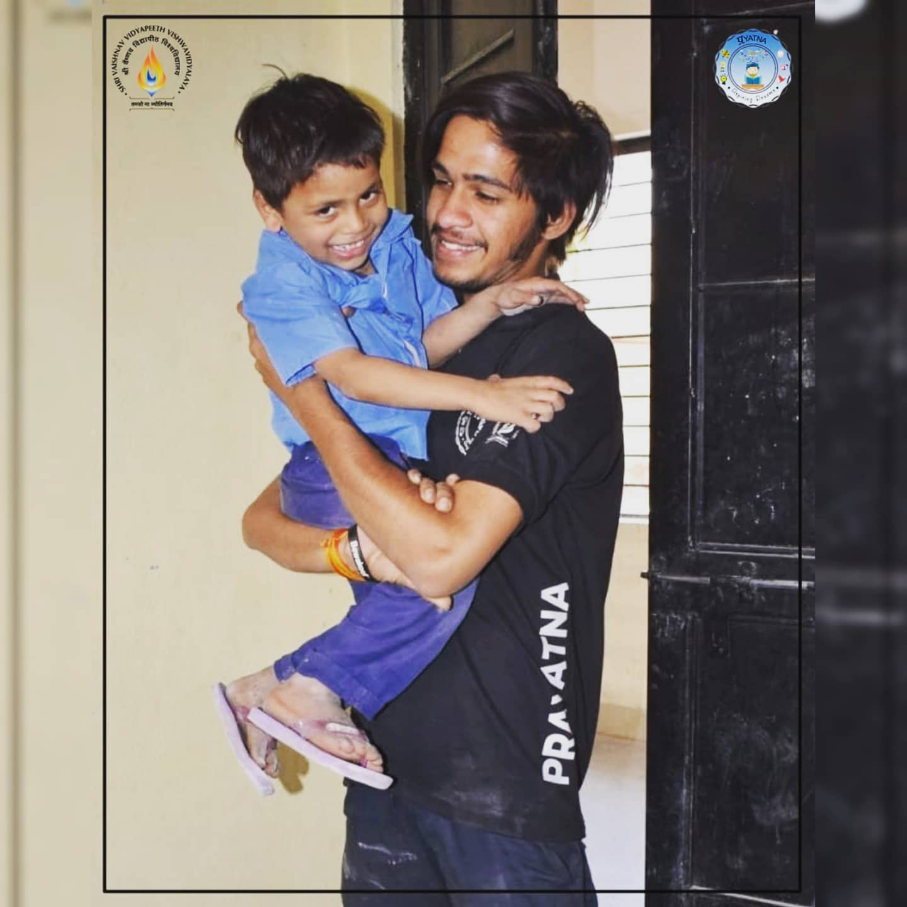
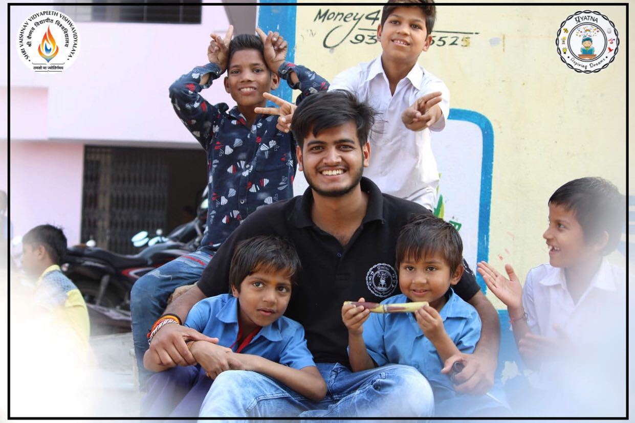

HOME ABOUT US STORIES OUR TEAM CONTACT US
Stories Of Happiness
Story headline
Story headline
Story headline

Slide 5
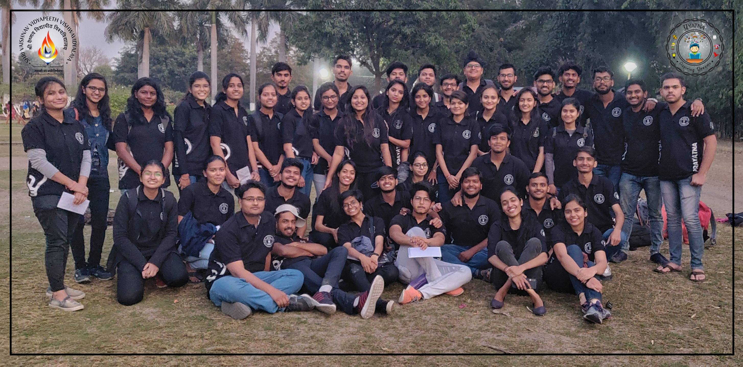
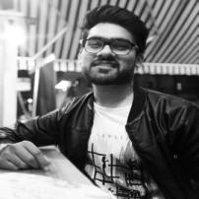
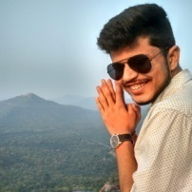
HOME ABOUT US STORIES OUR TEAM CONTACT US
OUR TEAM
पन्नों से सिमटा मैं |
कलम से बिखरा हूँ ||
परिभाषाओं से लिपटा मैं |
उदाहरणों से जुड़ा हूँ ||
तमस से डरता मैं |
रौशनी की राह हूँ ||
Mayank jain
President-Prayatna
Rishabh Bhargava
Secretary-Prayatna
Meet the team

Slide 6
HOME ABOUT US STORIES OUR TEAM CONTACT US
Meet the team
Former Members
Collage of former member with their names, image enlarges on pointing.

Slide 7
HOME ABOUT US STORIES OUR TEAM CONTACT US
Meet the team
Current Members
P R Dept.
R&D Dept.
Teaching Dept.
H R Dept.

Slide 8
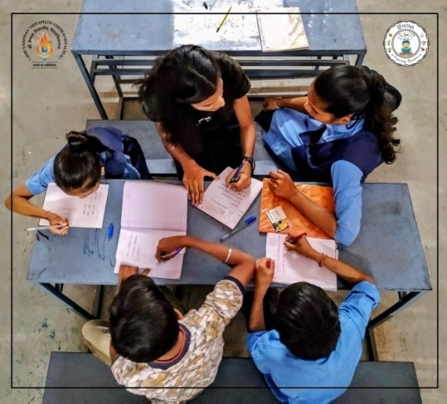
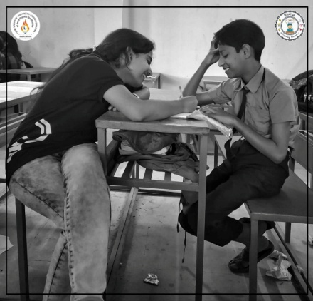
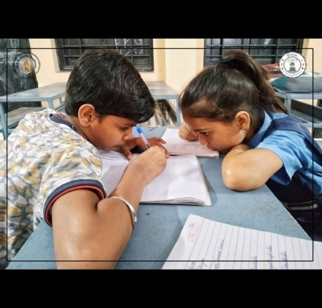
HOME ABOUT US STORIES OUR TEAM CONTACT US
Gallery
मुझे रास्ते कहाँ मालूम थे जब उम्मीदे जागी ,
मुझे मंज़िल कहाँ मालूम थी जब सपने जागे,
मुझे अन्त कहाँ मालूम था जब आरम्भ जागा।
Show more

Slide 9

HOME ABOUT US STORIES OUR TEAM CONTACT US
Contact Prayatna
Name
Email
Subject
Type your message here…
Thanks for submitting!
Submit

Slide 10
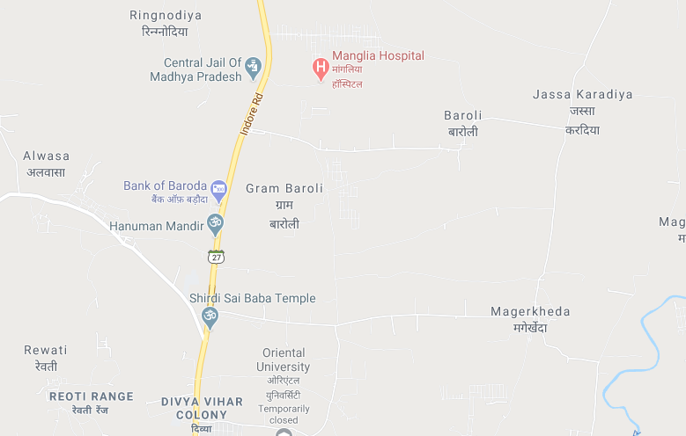

984403099909
Address

